Slide 1
Locating Services at Runtime Using Service Discovery

Slide 2
The role of service discovery in microservices
Problems with the status quo Describing Spring Cloud Eureka Creating a Eureka Server Registering services with Eureka Discovering services with Eureka Configuring health information Reviewing the high availability setup Options for advanced configuration Summary
Overview

Slide 3
Capabilities That We Will Add in This Module
Toll Data Repository
Toll Station UI
Service
Load Balancer
Circuit Breaker
Discovery
API Gateway
Messaging
Fast Pass Service
Remote Toll Data Pipeline
Toll Rate Lookup Service
Toll Intake Service

Slide 4




The Role of Service Discovery in Microservices
Recognize the dynamic environment
Use a live view of healthy services
Avoid hard- coded references to service locations
Centralize list of available services

Slide 5

Problems with the Status Quo
Outdated configuration management DBs
Simplistic HTTP 200 health checks Limited load balancing for middle-tier DNS is insufficient for microservices Registries can be single points of failure

Slide 6
Spring Cloud Eureka
Registry that acts as a phone- book for services.

Slide 7

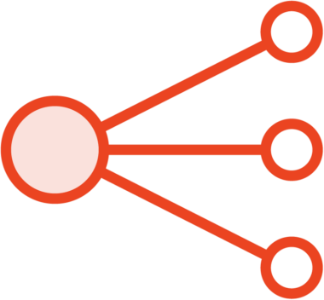
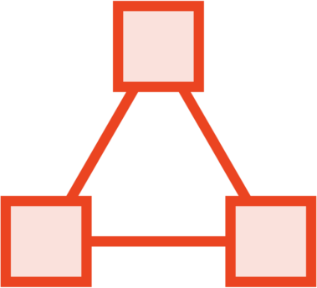
The History of Eureka
First released by the Netflix OSS team in 2012, with a 2.0. project discontinued, and 1.0 remaining the primary project
Used to support middle-tier load balancing
Integrated into many other Netflix OSS projects

Slide 8
Components of a Eureka Environment
Eureka Server
get registry
Service A Instance
Service A Instance
register
Service A Instance
Dashboard
Eureka Client
send heartbeat
make service call
get registry
Service B Instance
Service A Instance
register
Service A Instance
Eureka Client
send heartbeat

Slide 9



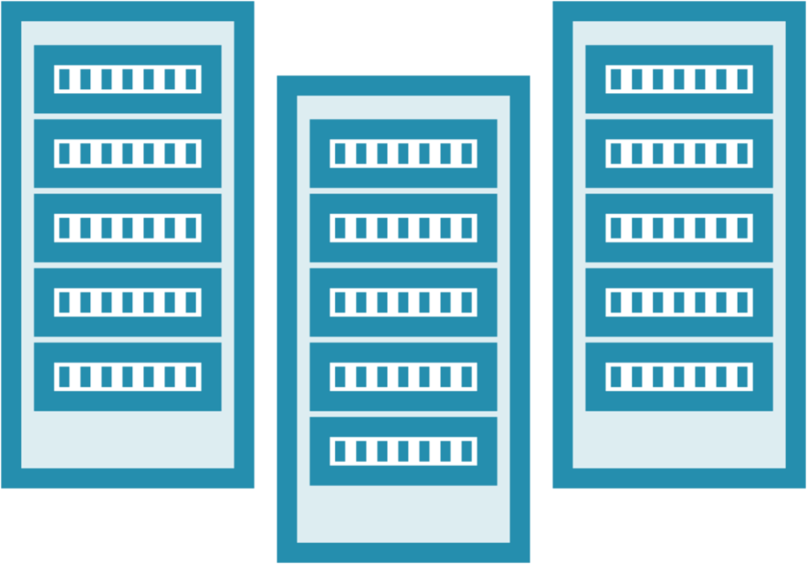
Creating a Eureka Server
Add spring- cloud-starter- netflix-eureka- server
Standalone or clustered configuration
Add @EnableEureka Server annotation
Many configuration options

Slide 10
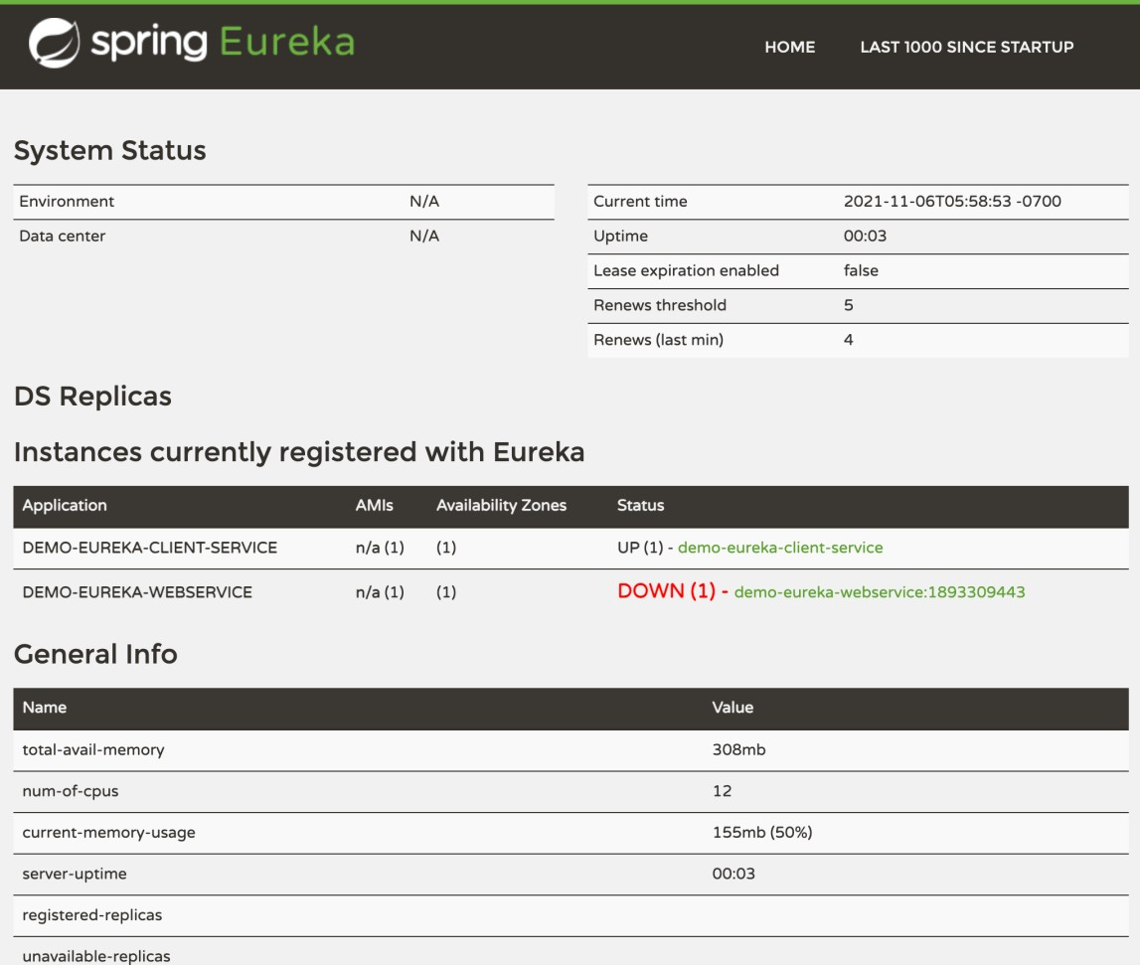
Using the Eureka Dashboard
Enabled by default
Shows environment info
Lists registered services and instances View service health

Slide 11

Start a new project via Spring Initializr
Add Eureka Server dependency Annotate primary class
Demo
Set application properties
Start server and view dashboard

Slide 12
Register a Service with Eureka
Eureka in classpath leads to registration
Service name and host set in application properties
Many client configurations
Sends heartbeat every 30 seconds
Heartbeat can include health status
HTTP and HTTPS
supported

Slide 13
Demo
Open existing “toll rate” microservice
Add project dependency on Eureka Add application properties
Start up microservice and see in registry Start a second instance and see in registry
Do same sequence with “fast pass customer” microservices

Slide 14
Discovering a Service with Eureka
Two types of discovery clients
Client works with a local cache
Cache refreshed and reconciled regularly
Manually load balance, or use Spring Cloud LoadBalancer
Can talk to registry
in closest “zone”
Can take multiple heartbeats to discover new services

Slide 15
Open “toll rate UI” application
Add dependency on Eureka Update application properties Add Load Balanced WebClient
Demo
Replace hard-coded URL with registry lookup
Test out “toll rate UI” application
Repeat with “fast pass console” application

Slide 16

Configuring Service Health Information
Heartbeat doesn’t convey health
Possible to include health information Can extend and create own health check

Slide 17
Demo
Return to “toll rate” microservice and add a
custom health check
Start up microservice and wait for error See service taken out of rotation by Eureka

Slide 18




High Availability Architecture for Eureka
Built in “self preservation” mode
Support for peer-to-peer registry replication
Can use DNS in front of Eureka cluster
Suggested to have one Eureka server per “zone”

Slide 19

Advanced Configuration Options
Dozens and dozens of configuration flags
Set cache refresh intervals Set timeouts
Set connection limits
Set service metadataMap
Override default service, health endpoints Define replication limits, timeout, retries

Slide 20
The role of service discovery in microservices
Problems with the status quo Describing Spring Cloud Eureka Creating a Eureka Server Registering services with Eureka Discovering services with Eureka Configuring health information Reviewing the high availability setup Options for advanced configuration
Summary

